Slide 1

Cloud Computing and Big Data Processing
Shivaram Venkataraman
UC Berkeley, AMP Lab
Slides from Matei Zaharia
UC BERKELEY

Slide 2




Cloud Computing, Big Data

Slide 3


Hardware

Slide 4




Software
Open MPI

Slide 5
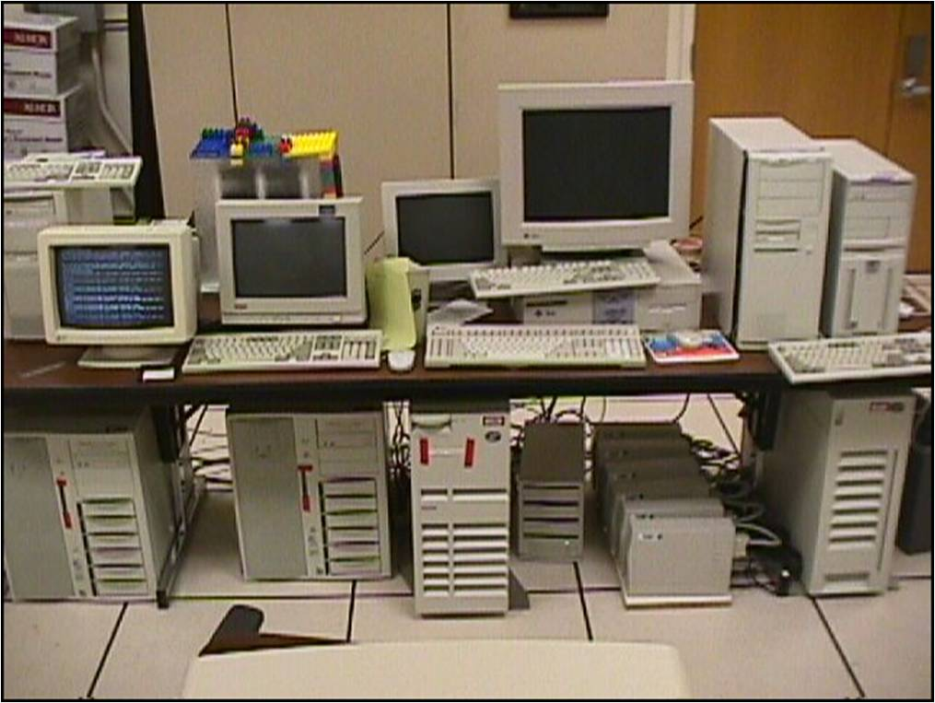
Google 1997

Slide 6
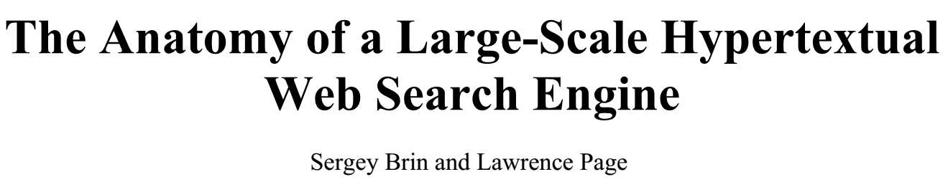
Data, Data, Data
“…Storage space must be used efficiently to store indices and, optionally, the documents themselves. The indexing system must process hundreds of gigabytes of data efficiently…”

Slide 7
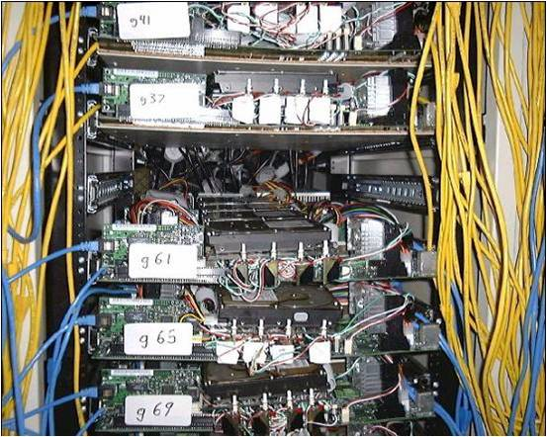
Google 2001
Commodity CPUs
Lots of disks
Low bandwidth network
Cheap !

Slide 8
Datacenter evolution
Facebook’s daily logs: 60 TB
1000 genomes project: 200 TB
Google web index: 10+ PB
(IDC report*)
Slide from Ion Stoica

Slide 9
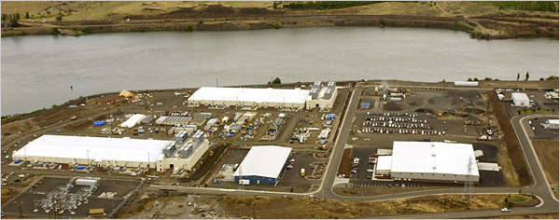
Datacenter Evolution
Google data centers in The Dalles, Oregon

Slide 10
Datacenter Evolution
Capacity:
~10000 machines
Bandwidth:
12-24 disks per node
Latency:
256GB RAM cache

Slide 11
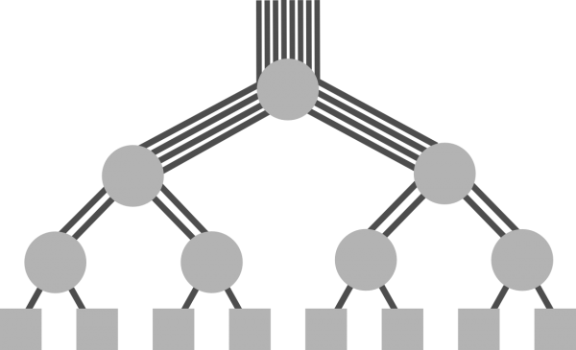
Datacenter Networking
Initially tree topology
Over subscribed links
Fat tree, Bcube, VL2 etc.
Lots of research to get
full bisection bandwidth

Slide 12

Datacenter Design
Goals
Power usage effectiveness (PUE)
Cost-efficiency
Custom machine design
Open Compute Project
(Facebook)

Slide 13
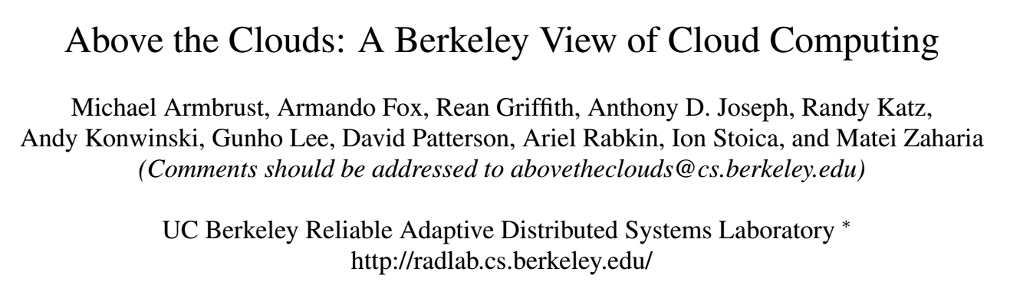

Datacenters → Cloud Computing
“…long-held dream of computing as a utility…”

Slide 14


From Mid 2006
Rent virtual computers in the “Cloud”
On-demand machines, spot pricing

Slide 15
Amazon EC2
Machine | Memory (GB) | Compute Units (ECU) | Local Storage (GB) | Cost / hour
t1.micro | 0.615 | 2 | 0 | $0.02
m1.xlarge | 15 | 8 | 1680 | $0.48
cc2.8xlarge | 60.5 | 88 (Xeon 2670) | 3360 | $2.40
1 ECU = CPU capacity of a 1.0-1.2 GHz 2007 Opteron or 2007 Xeon processor

Slide 16
Hardware

Slide 17
Hopper vs. Datacenter
 | Hopper | Datacenter²
Nodes | 6384 | 1000s to 10000s
CPUs (per node) | 2x12 cores | ~2x6 cores
Memory (per node) | 32-64GB | ~48-128GB
Storage (overall) | ~4 PB | 120-480 PB
Interconnect | ~ 66.4 Gbps | ~10Gbps
²http://blog.cloudera.com/blog/2013/08/how-to-select-the-right-hardware-for-your-new-hadoop-cluster/

Slide 18
Summary
Focus on Storage vs. FLOPS
Scale out with commodity components
Pay-as-you-go model
Notes:
Hardly any GPUs

Slide 20
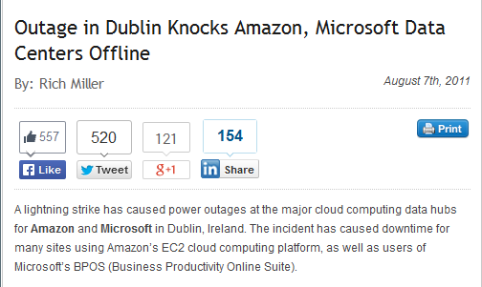
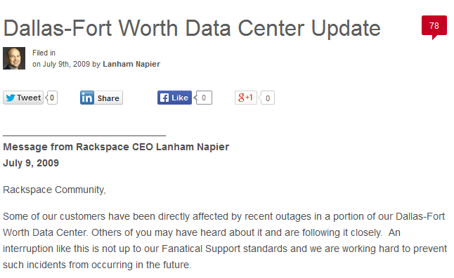
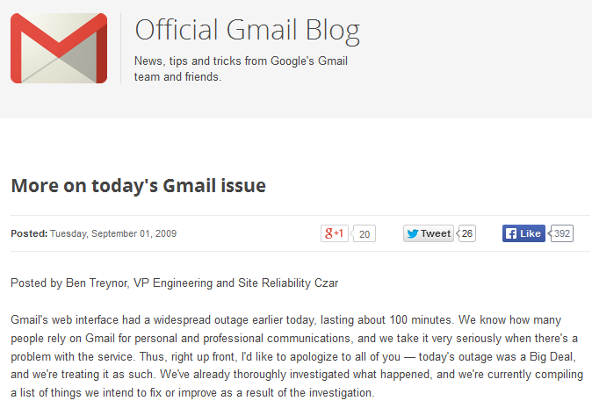
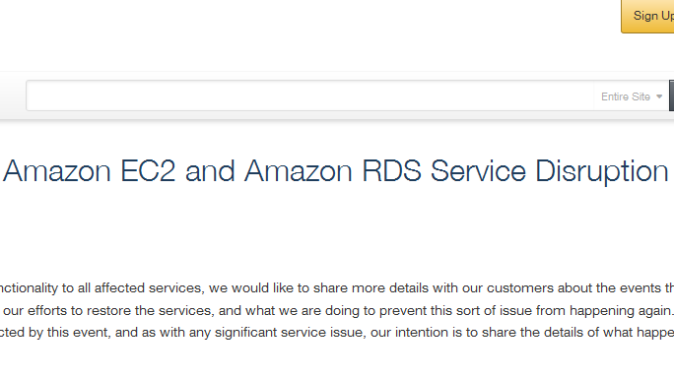

Slide 21
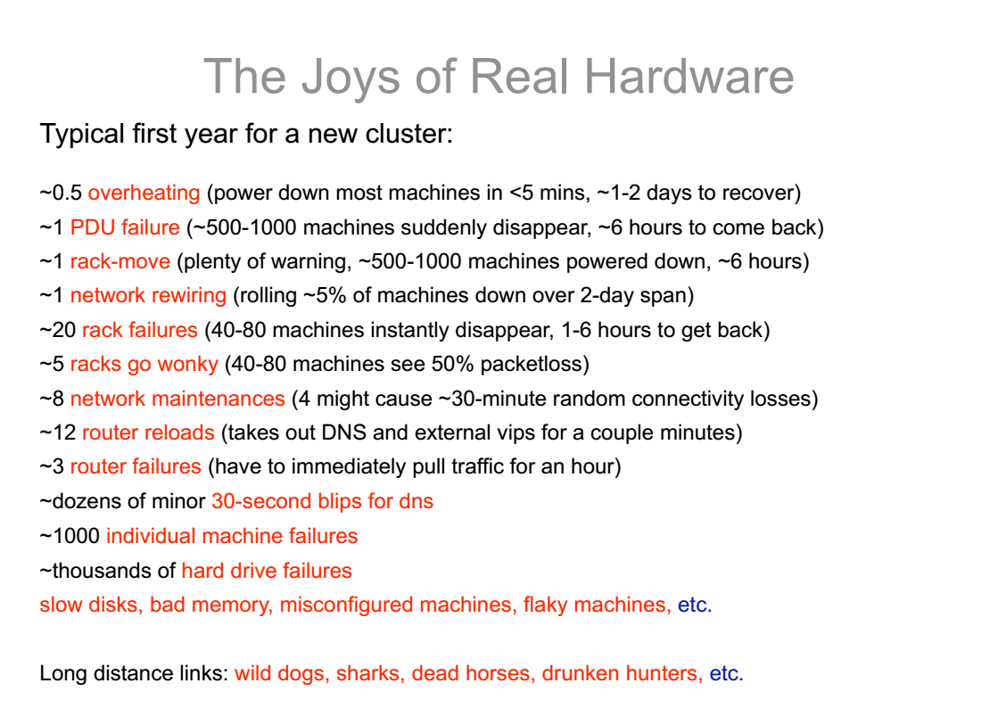
Jeff Dean @ Google

Slide 22
How do we program this ?

Slide 23
Programming Models
Message Passing Models (MPI)
Fine-grained messages + computation
Hard to deal with disk locality, failures, stragglers
1 server fails every 3 years →
10K nodes see 10 faults/day

Slide 24
Programming Models
Data Parallel Models
Restrict the programming interface
Automatically handle failures, locality etc.
“Here’s an operation, run it on all of the data”
I don’t care where it runs (you schedule that)
In fact, feel free to run it retry on different nodes

Slide 25
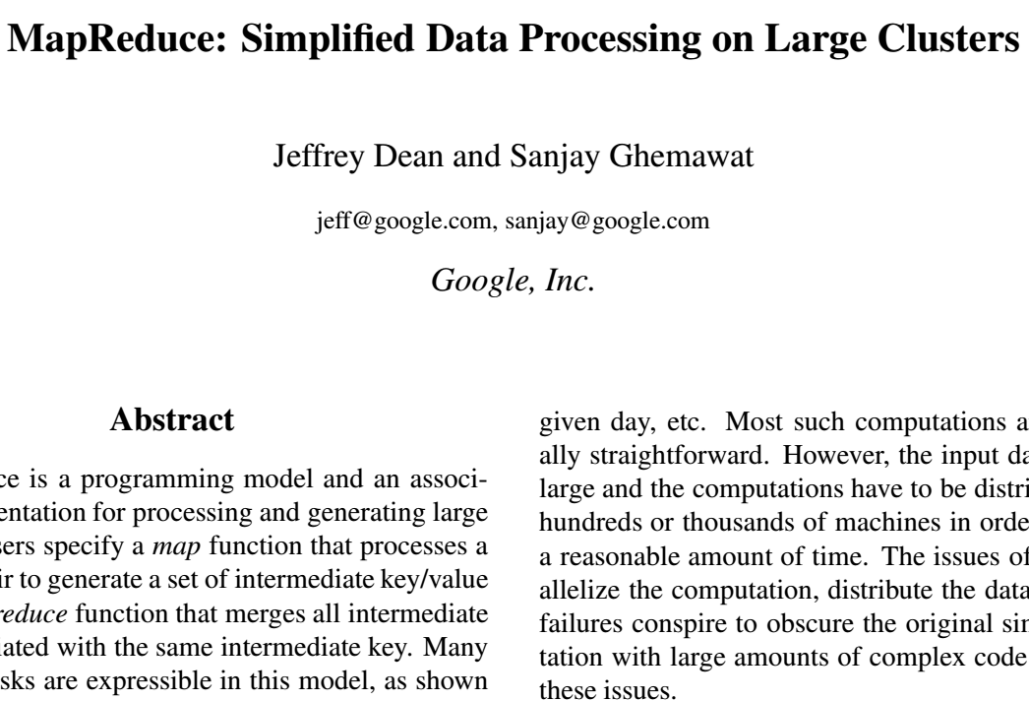
MapReduce
Google 2004
Build search index
Compute PageRank
Hadoop: Open-source
at Yahoo, Facebook

Slide 26
MapReduce Programming Model
Data type: Each record is (key, value)
Map function:
(K_{in}, V_{in}) → list(K_{inter}, V_{inter})
Reduce function:
(K_{inter}, list(V_{inter})) → list(K_{out}, V_{out})

Slide 27
Example: Word Count
def mapper(line):
for word in line.split():
output(word, 1)
def reducer(key, values):
output(key, sum(values))

Slide 28
Word Count Execution
Input
Map
Shuffle & Sort
Reduce
Output
the, 1
brown, 1
fox, 1
the quick
brown fox
brown, 2
fox, 2
how, 1
now, 1
the, 3
Map
Reduce
the, 1
fox, 1
the, 1
the fox ate the mouse
Map
quick, 1
how, 1
now, 1
brown, 1
ate, 1
cow, 1
mouse, 1
quick, 1
ate, 1
mouse, 1
Reduce
how now
brown cow
Map
cow, 1

Slide 29

Word Count Execution
Submit a Job
JobTracker
Schedule tasks
with locality
Automatically split work
Map
Map
Map
the quick
brown fox
the fox ate the mouse
how now
brown cow

Slide 30
Fault Recovery
If a task crashes:
Retry on another node
If the same task repeatedly fails, end the job
Map
Map
Map
the quick
brown fox
the fox ate the mouse
how now
brown cow
Requires user code to be deterministic

Slide 31
Fault Recovery
If a node crashes:
Relaunch its current tasks on other nodes
Relaunch tasks whose outputs were lost
Map
Map
Map
the quick
brown fox
the fox ate the mouse
how now
brown cow

Slide 32
Fault Recovery
If a task is going slowly (straggler):
Launch second copy of task on another node
Take the output of whichever finishes first
Map
Map
Map
Map
the quick
brown fox
the quick
brown fox
the fox ate the mouse
how now
brown cow

Slide 33
Applications

Slide 34
1. Search
Input: (lineNumber, line) records
Output: lines matching a given pattern
Map: if(line matches pattern): output(line)
Reduce: Identity function
Alternative: no reducer (map-only job)

Slide 35
2. Inverted Index
hamlet.txt
to be or not to be
afraid, (12th.txt)
be, (12th.txt, hamlet.txt)
greatness, (12th.txt)
not, (12th.txt, hamlet.txt)
of, (12th.txt)
or, (hamlet.txt)
to, (hamlet.txt)
12th.txt
be not afraid of greatness

Slide 36
2. Inverted Index
Input: (filename, text) records
Output: list of files containing each word
Map: foreach word in text.split(): output(word, filename)
Reduce: def reduce(word, filenames): output(word, unique(filenames))

Slide 37
2.Inverted Index
hamlet.txt
to, hamlet.txt
be, hamlet.txt
or, hamlet.txt
not, hamlet.txt
to be or not to be
afraid, (12th.txt)
be, (12th.txt, hamlet.txt)
greatness, (12th.txt)
not, (12th.txt, hamlet.txt)
of, (12th.txt)
or, (hamlet.txt)
to, (hamlet.txt)
12th.txt
be, 12th.txt
not, 12th.txt
afraid, 12th.txt
of, 12th.txt
greatness, 12th.txt
be not afraid of greatness

Slide 38
MPI
Parallel process model
Fine grain control
High Performance
MapReduce
High level data-parallel
Automate locality, data transfers
Focus on fault tolerance

Slide 39
Summary
MapReduce data-parallel model
Simplified cluster programming
Automates
Division of job into tasks
Locality-aware scheduling
Load balancing
Recovery from failures & stragglers

Slide 40
When an Abstraction is Useful…
People want to compose it!
Most real applications require multiple MR steps
Google indexing pipeline: 21 steps
Analytics queries (e.g. sessions, top K): 2-5 steps
Iterative algorithms (e.g. PageRank): 10’s of steps
MapReduce
MapReduce
MapReduce

Slide 41
Programmability
Multi-step jobs create spaghetti code
21 MR steps → 21 mapper and reducer classes
Lots of boilerplate wrapper code per step
API doesn’t provide type safety

Slide 42
Performance
MR only provides one pass of computation
Must write out data to file system in-between
Expensive for apps that need to reuse data
Multi-step algorithms (e.g. PageRank)
Interactive data mining

Slide 43
Spark
Programmability: clean, functional API
Parallel transformations on collections
5-10x less code than MR
Available in Scala, Java, Python and R
Performance
In-memory computing primitives
Optimization across operators

Slide 44
Spark Programmability
Google MapReduce WordCount:
#include "mapreduce/mapreduce.h"
// User’s map function
class SplitWords: public Mapper {
public:
virtual void Map(const MapInput& input)
{
const string& text = input.value();
const int n = text.size();
for (int i = 0; i < n; ) {
// Skip past leading whitespace
while (i < n && isspace(text[i]))
i++;
// Find word end
int start = i;
while (i < n && !isspace(text[i]))
i++;
if (start < i)
Emit(text.substr( start,i-start),"1");
}
}
};
REGISTER_MAPPER(SplitWords);
// User’s reduce function
class Sum: public Reducer {
public:
virtual void Reduce(ReduceInput* input)
{
// Iterate over all entries with the
// same key and add the values
int64 value = 0;
while (!input->done()) {
value += StringToInt(
input->value());
input->NextValue();
}
// Emit sum for input->key()
Emit(IntToString(value));
}
};
REGISTER_REDUCER(Sum);
int main(int argc, char** argv) {
ParseCommandLineFlags(argc, argv);
MapReduceSpecification spec;
for (int i = 1; i < argc; i++) {
MapReduceInput* in= spec.add_input();
in->set_format("text");
in->set_filepattern(argv[i]);
in->set_mapper_class("SplitWords");
}
// Specify the output files
MapReduceOutput* out = spec.output();
out->set_filebase("/gfs/test/freq");
out->set_num_tasks(100);
out->set_format("text");
out->set_reducer_class("Sum");
// Do partial sums within map
out->set_combiner_class("Sum");
// Tuning parameters
spec.set_machines(2000);
spec.set_map_megabytes(100);
spec.set_reduce_megabytes(100);
// Now run it
MapReduceResult result;
if (!MapReduce(spec, &result)) abort();
return 0;
}

Slide 45
Spark Programmability
Spark WordCount:
val file = spark.textFile(“hdfs://...”)
val counts = file.flatMap(line => line.split(“ ”)) .map(word => (word, 1)) .reduceByKey(_ + _) counts.save(“out.txt”)

Slide 46
Spark Performance
Iterative algorithms:
sec
sec

Slide 47
Spark Concepts
Resilient distributed datasets (RDDs)
Immutable, partitioned collections of objects
May be cached in memory for fast reuse
Operations on RDDs
Transformations (build RDDs)
Actions (compute results)
Restricted shared variables
Broadcast, accumulators
Notes:
You write a single program → similar to DryadLINQ
Distributed data sets with parallel operations on them are pretty standard; the new thing is that they can be reused across ops
Variables in the driver program can be used in parallel ops; accumulators useful for sending information back, cached vars are an optimization
Mention cached vars useful for some workloads that won’t be shown here
Mention it’s all designed to be easy to distribute in a fault-tolerant fashion

Slide 48
Example: Log Mining
Load error messages from a log into memory, then interactively search for various patterns
Base RDD
Cache 1
lines = spark.textFile(“hdfs://...”)
errors = lines.filter(_.startsWith(“ERROR”))
messages = errors.map(_.split(‘\t’)(2))
messages.cache()
Transformed RDD
Worker
results
tasks
Block 1
Driver
Action
messages.filter(_.contains(“foo”)).count
messages.filter(_.contains(“bar”)).count
Cache 2
Worker
. . .
Cache 3
Result: full-text search of Wikipedia in <1 sec (vs 20 sec for on-disk data)
Worker
Block 2
Result: search 1 TB data in 5-7 sec (vs 170 sec for on-disk data)
Block 3
Notes:
Key idea: add “variables” to the “functions” in functional programming

Slide 49
Fault Recovery
RDDs track lineage information that can be used to efficiently reconstruct lost partitions
Ex:
messages = textFile(...).filter(_.startsWith(“ERROR”))
.map(_.split(‘\t’)(2))
HDFS File
Filtered RDD
Mapped RDD
filter (func = _.contains(...))
map (func = _.split(...))

Slide 50
Demo

Slide 51
Example: Logistic Regression
Goal: find best line separating two sets of points
random initial line
+
+
+
+
+
+
–
+
+
–
–
–
+
+
–
–
–
–
–
–
target
Notes:
Note that dataset is reused on each gradient computation

Slide 52
Example: Logistic Regression
val data = spark.textFile(...).map(readPoint).cache()
var w = Vector.random(D)
for (i <- 1 to ITERATIONS) {
val gradient = data.map(p =>
(1 / (1 + exp(-p.y*(w dot p.x))) - 1) * p.y * p.x
).reduce(_ + _)
w -= gradient
}
println("Final w: " + w)
w automatically shipped to cluster
Notes:
Key idea: add “variables” to the “functions” in functional programming

Slide 53
Logistic Regression Performance
110 s / iteration
first iteration 80 s
further iterations 1 s
Notes:
This is for a 29 GB dataset on 20 EC2 m1.xlarge machines (4 cores each)

Slide 54
Shared Variables
RDD operations: use local variables from scope
Two other kinds of shared variables:
Broadcast Variables
Accumulators

Slide 55
Broadcast Variables
val data = spark.textFile(...).map(readPoint).cache()
// Random Projection
val M = Matrix.random(N)
var w = Vector.random(D)
for (i <- 1 to ITERATIONS) {
val gradient = data.map(p =>
(1 / (1 + exp(-p.y*(w.dot(p.x.dot(M)))) - 1)
* p.y * p.x
).reduce(_ + _)
w -= gradient
}
println("Final w: " + w)
Large Matrix
Problem: M re-sent to all nodes in each iteration

Slide 56
Broadcast Variables
val data = spark.textFile(...).map(readPoint).cache()
// Random Projection
Val M = spark.broadcast(Matrix.random(N))
var w = Vector.random(D)
for (i <- 1 to ITERATIONS) {
val gradient = data.map(p =>
(1 / (1 + exp(-p.y*(w.dot(p.x.dot(M.value)))) - 1) * p.y * p.x
).reduce(_ + _)
w -= gradient
}
println("Final w: " + w)
Solution: mark M as broadcast variable

Slide 57
Other RDD Operations
Transformations (define a new RDD) | map filter sample groupByKey reduceByKey cogroup | flatMap union join cross mapValues ...
Actions (output a result) | collect reduce take fold | count saveAsTextFile saveAsHadoopFile ...

Slide 58
Java
JavaRDD<String> lines = sc.textFile(...); lines.filter(new Function<String, Boolean>() { Boolean call(String s) { return s.contains(“error”); } }).count();
Python
lines = sc.textFile(...) lines.filter(lambda x: “error” in x).count()
R
lines ← textFile(sc, ...) filter(lines, function(x) grepl(“error”, x))

Slide 59
Job Scheduler
Captures RDD dependency graph
Pipelines functions into “stages”
Cache-aware for data reuse & locality
Partitioning-aware to avoid shuffles
A:
B:
G:
Stage 1
groupBy
C:
D:
F:
map
E:
join
Stage 2
union
Stage 3
= cached partition
Notes:
NOT a modified version of Hadoop

Slide 60
Higher-Level Abstractions
SparkStreaming: API for streaming data
GraphX: Graph processing model
MLLib: Machine learning library
Shark: SQL queries

Slide 61


Hands-on Exercises using Spark, Shark etc.
~250 in person
3000 online
http://ampcamp.berkeley.edu

Slide 62
Course Project Ideas
Linear Algebra on commodity clusters
Optimizing algorithms
Cost model for datacenter topology
Measurement studies
Comparing EC2 vs Hopper
Optimizing BLAS for virtual machines

Slide 63
Conclusion
Commodity clusters needed for big data
Key challenges: Fault tolerance, stragglers
Data-parallel models: MapReduce and Spark
Simplify programming
Handle faults automatically

